Slide 1

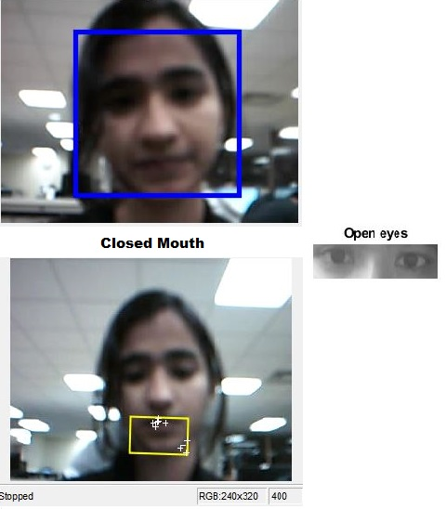
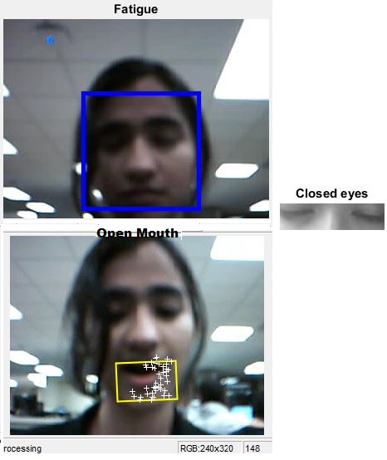
FATIGUE RECOGNITION SYSTEM USING IMAGE PROCESSING
DEEPIKA NARAYANAN, VIGNESH SRIDHARAN
POSTER No.
27
ECE6258 – Fall 2015
Objective & Problem Description
The proposed system is based on the Viola-Jones face detection algorithm wherein features from a detected face are extracted and analysed to determine the driver’s aptitude.
The designed system detects the state of the eye and the mouth (along with simultaneous tracking of the face movement) to cumulatively evaluate the fatigue status of the driver.
To design and implement a completely non-invasive monitoring system to detect conditions of fatigue in an automobile driver and provide an alert thus reducing risk of accidents.
The National Highway Traffic Safety Administration conservatively estimates that 100,000 police-reported crashes are the direct result of driver fatigue each year. About 168 million people say they have driven a vehicle while feeling drowsy in the past year, and more than one-third, (37% or 103 million people), have actually fallen asleep at the wheel!
Existing systems impose a hardware overhead and experience reliability and accuracy issues.
Assessment of Results
Test Case | Expected Output | Obtained Output | Result
Detecting & tracking face | Face detected & tracked | Face detected & tracked | Pass
Detecting features | Eyes & Mouth detected | Eyes & Mouth detected | Pass
Eyes Open| Close | Non-Fatigue|Fatigue-Alert | Non-Fatigue|Fatigue-Alert | Pass
Mouth Open| Close | Fatigue- Alert| Non- Fatigue | Fatigue- Alert| Non- Fatigue | Pass
Illumination- Low | Fatigue | Alert (100%) | Alert (<100%) | Fail
Illumination- High | Fatigue | Alert (100%) | Alert (100%) | Pass
Ideas & Methodology
START
ACCESS LIVE VIDEO RELAY OF DRIVER
SEGMENT EYES/MOUTH REGION FROM FRAMES
Accuracy: [Under normal illumination]
Face detection : 100%
Eye detection : 100%
Mouth detection : 90-100%
EVALUATE FATIGUE METRIC
IF METRIC > THRESHOLD
NO
Conclusions
The developed system provides a completely non-invasive method using image processing to accurately detect a driver’s fatigue condition and provide an alert signal. Improvement over existing systems that employ IR sensors and heavy hardware requirements thereby making this a low cost, easily deployable technology. However, the proposed system is limited by surrounding illumination that affects its robustness. It is also limited by the quality (resolution) of the Image Acquisition system used.
ALERT
STOP

